Slide 1
Attitude Determination and Control System Testbed
Athul Kodancha, Joe Dubois
Notes:
Title

Slide 2
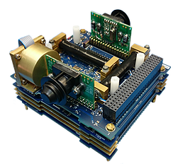
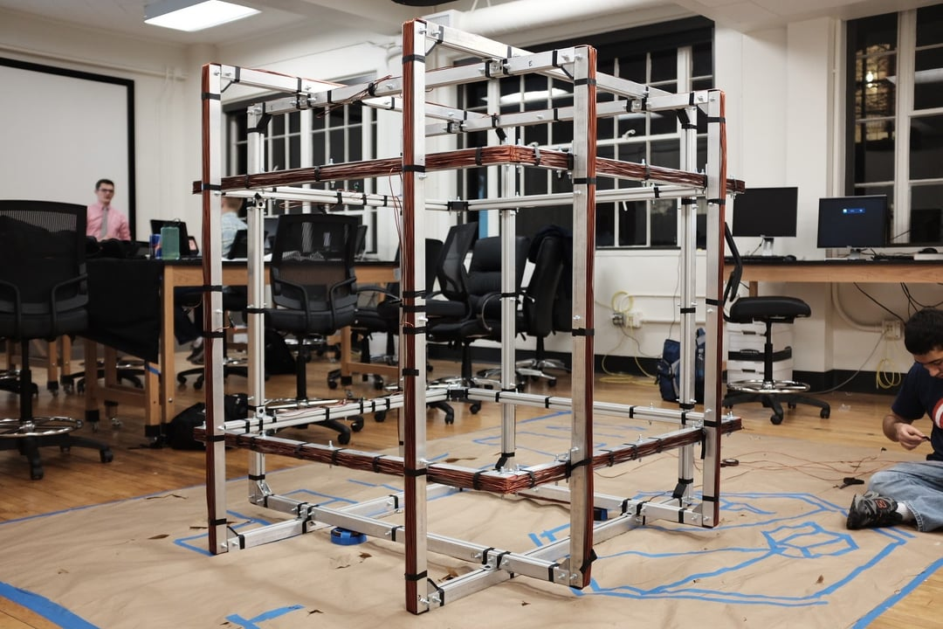
Introduction
What is ADCS? Ensures spacecraft maintain precise orientation for mission success.
Why Build a Testbed? Ground-based simulations ensure reliability before deployment.
Project Overview: Developing a 3-axis Helmholtz cage + 3-axis gimbal for controlled testing.
Impact: Supports research in attitude stabilization, refining ADCS algorithms and hardware for future satellite advancements.

Slide 3
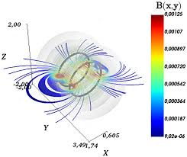
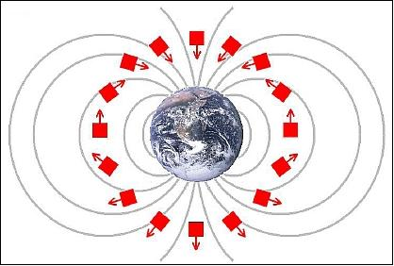
Objectives
Magnetic Field Simulation – Build a 3-axis Helmholtz cage generating a homogeneous 3 Gauss magnetic field for testing.
Scalable Design – Ensure an internal volume of 0.125 m³ to accommodate a 6U CubeSat test platform.
Performance Evaluation – Develop a test cube to analyze ADCS functionality and response under simulated space conditions.
Control System Implementation – Integrate and refine attitude stabilization algorithms for accurate positioning control.
Hardware Validation – Conduct sensor and actuator testing using simulations and real-world experiments to verify reliability.

Slide 4
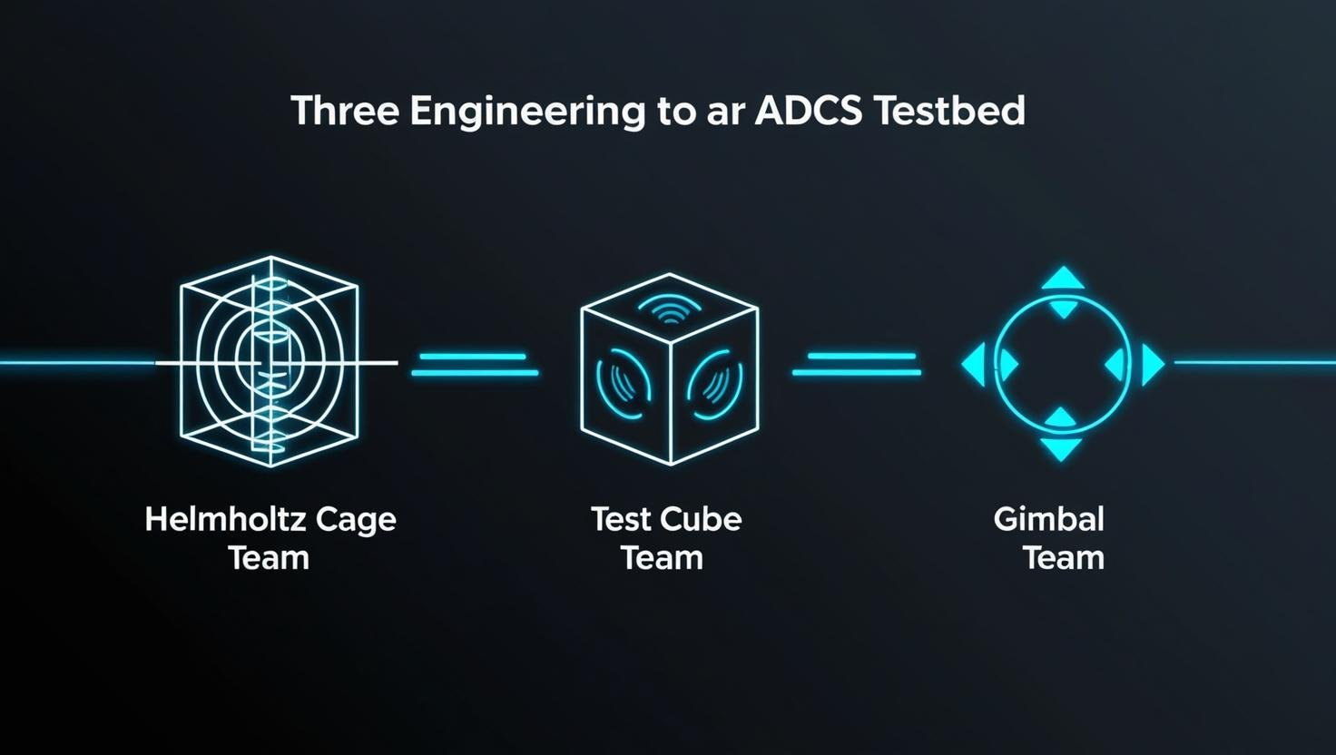
Methodology

Slide 5
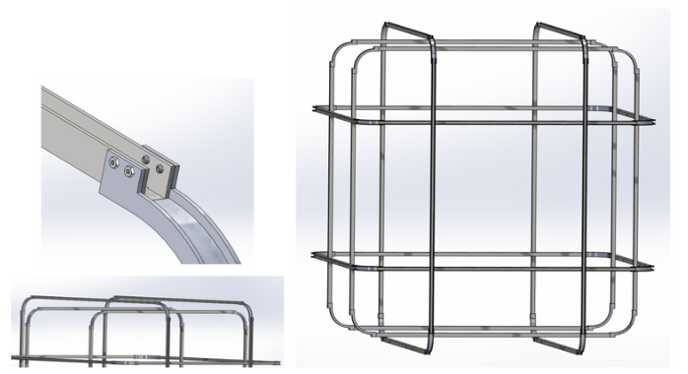
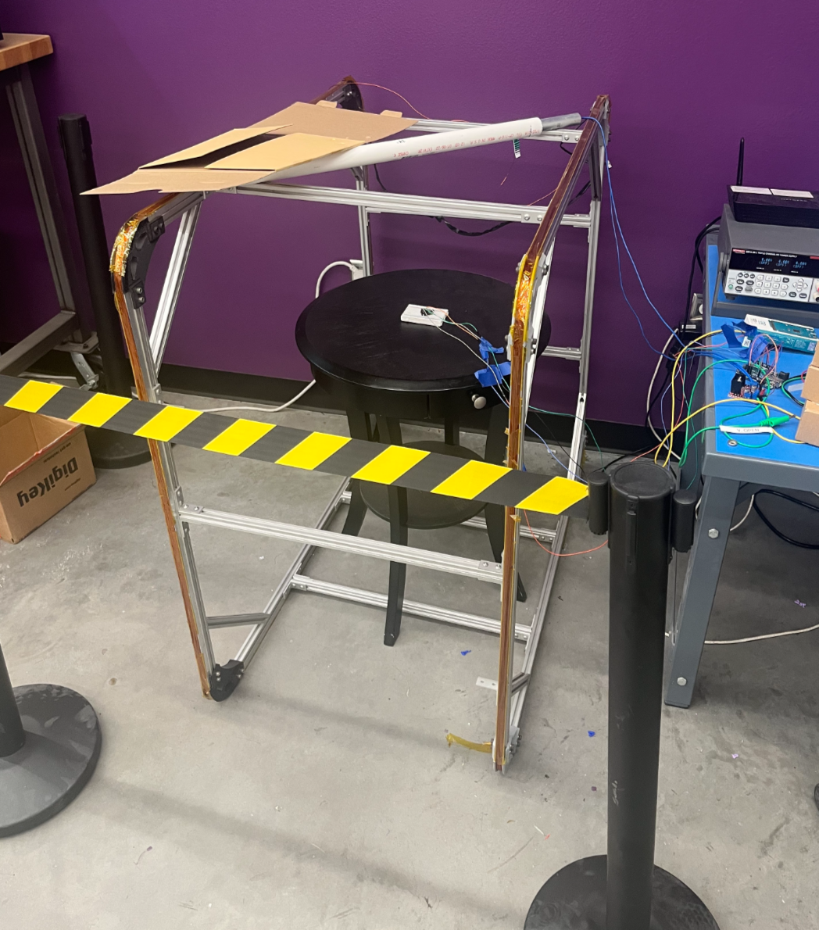
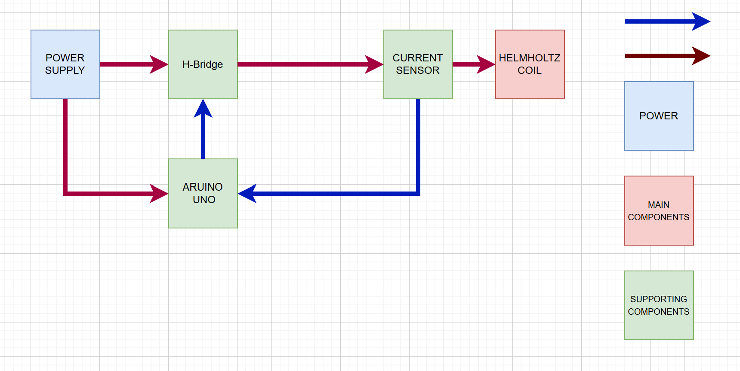
Cage
Purpose: Generates a uniform, controlled magnetic field (3 Gauss) to simulate space conditions for ADCS testing.
Core Features:
3-axis Helmholtz coil configuration for precise field control.
Adjustable field strength to replicate orbital conditions.
0.125 m³ internal volume to accommodate CubeSat testing.
Importance to ADCS Validation: Provides a consistent magnetic environment for evaluating ADCS accuracy before deployment of spacecraft.

Slide 6
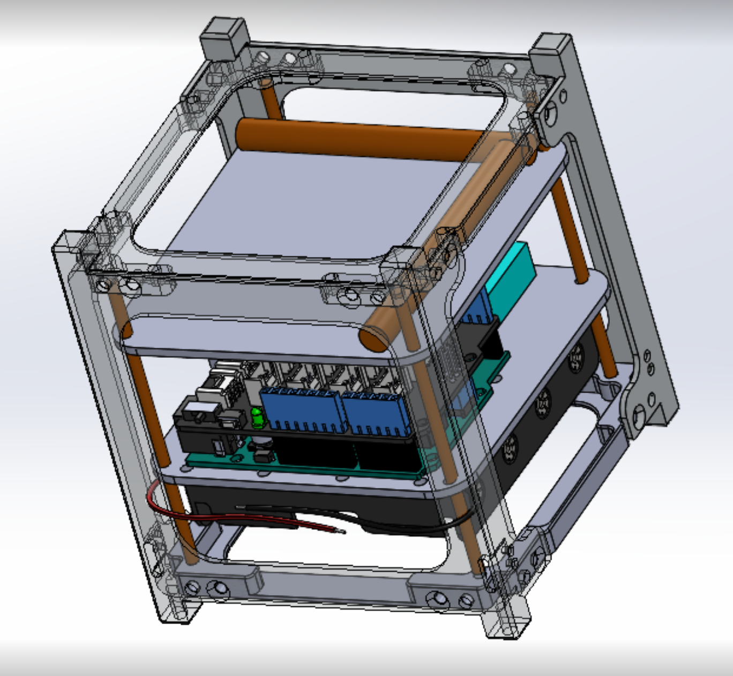
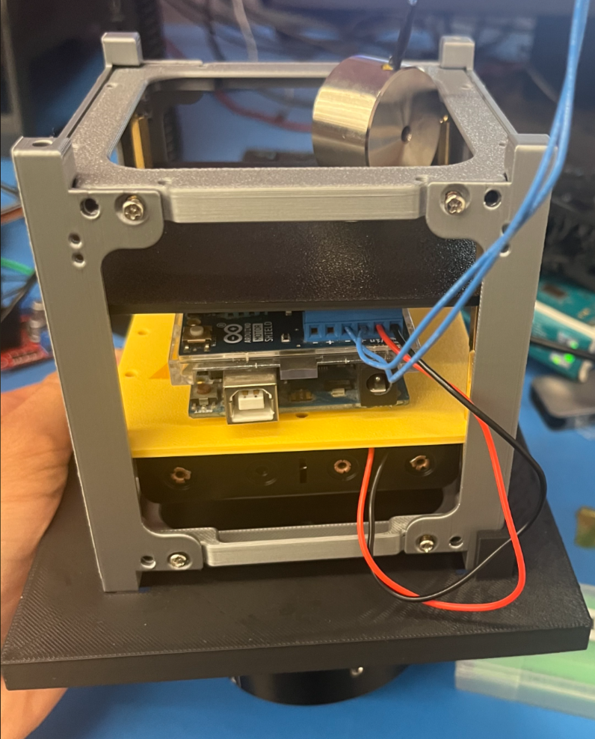
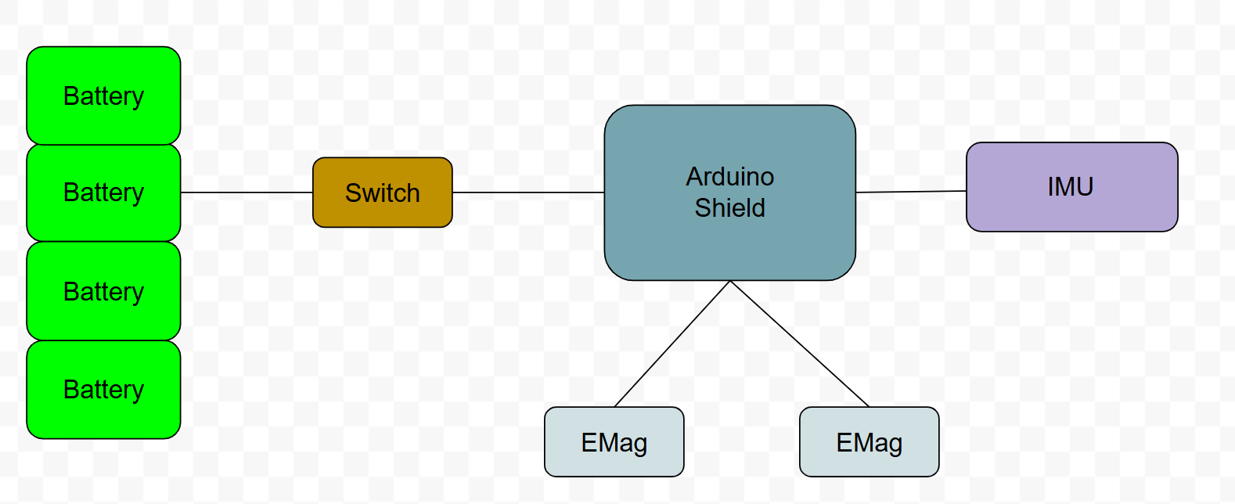
Test Cube
What is the Test Cube? – a platform for testing control algorithms and actuators before launching into orbit.
Core Components – Actuators, IMUs, power system, and control interface.
Functionality: This platform helps bridge the gap between theoretical designs and real-world performance by validating hardware and software interactions.
Why It’s Important? By testing actuators and control systems in a ground-based setting, engineers can refine and troubleshoot potential failures before deployment.

Slide 7

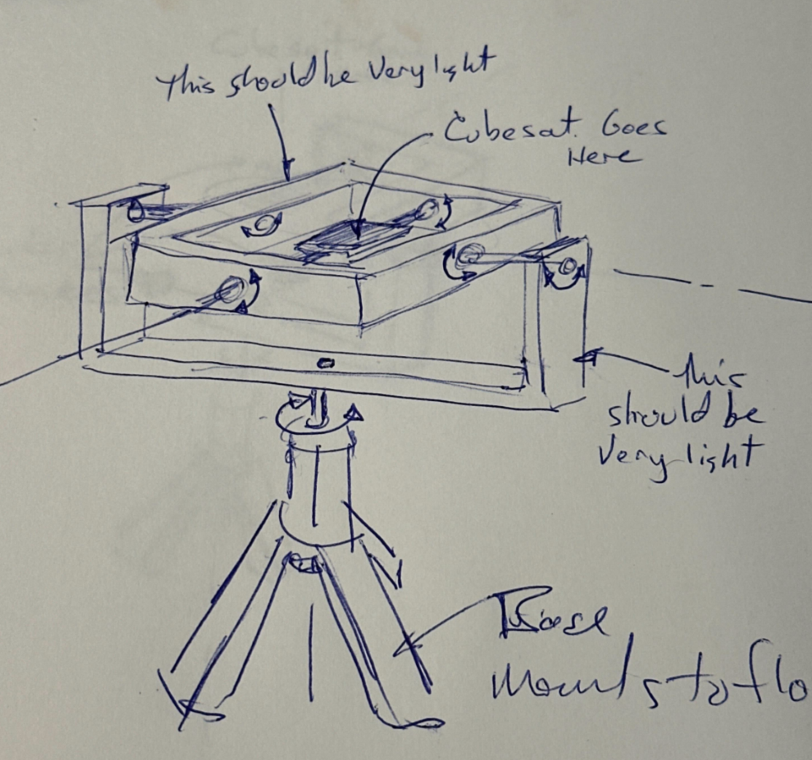
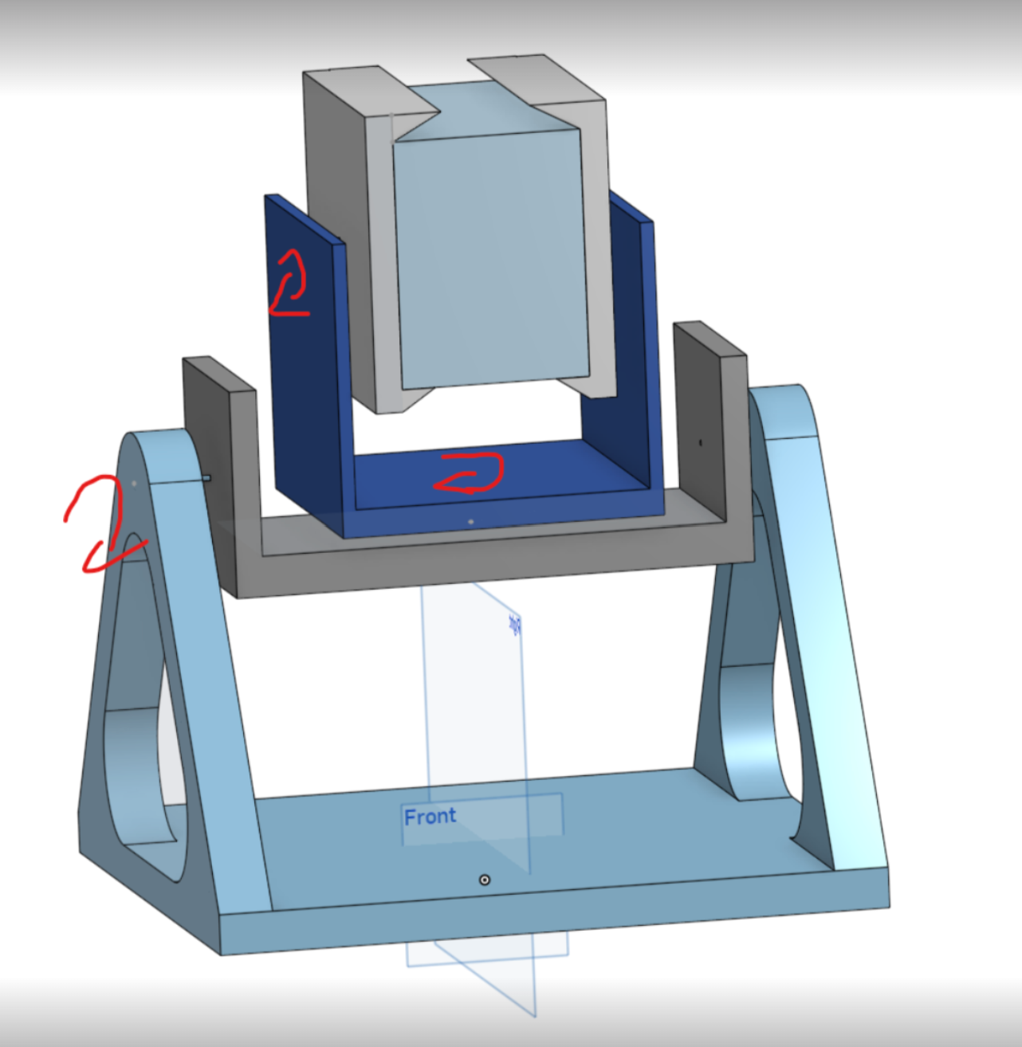
Gimbal
Purpose: The gimbal system provides unrestricted movement, allowing ADCS algorithms to be tested in a controlled environment that mimics real spacecraft behavior.
Core Features:
Frictionless Bearings: allow for full rotation along each axis
Counterweights: Support CubeSat weight and mass imbalance
Importance to ADCS Validation: By allowing full rotational movement, the gimbal system helps verify sensor readings, actuator responses, and overall ADCS performance under simulated space conditions.

Slide 8
Acknowledgements
Thank you
Quang Huy Dinh
Preeti Vaddey
Lee Sorsen
Tyler Santos
Lewin Elep
Cole Nelson
Micah Nguyen

Slide 9
Questions?

